Slide 1


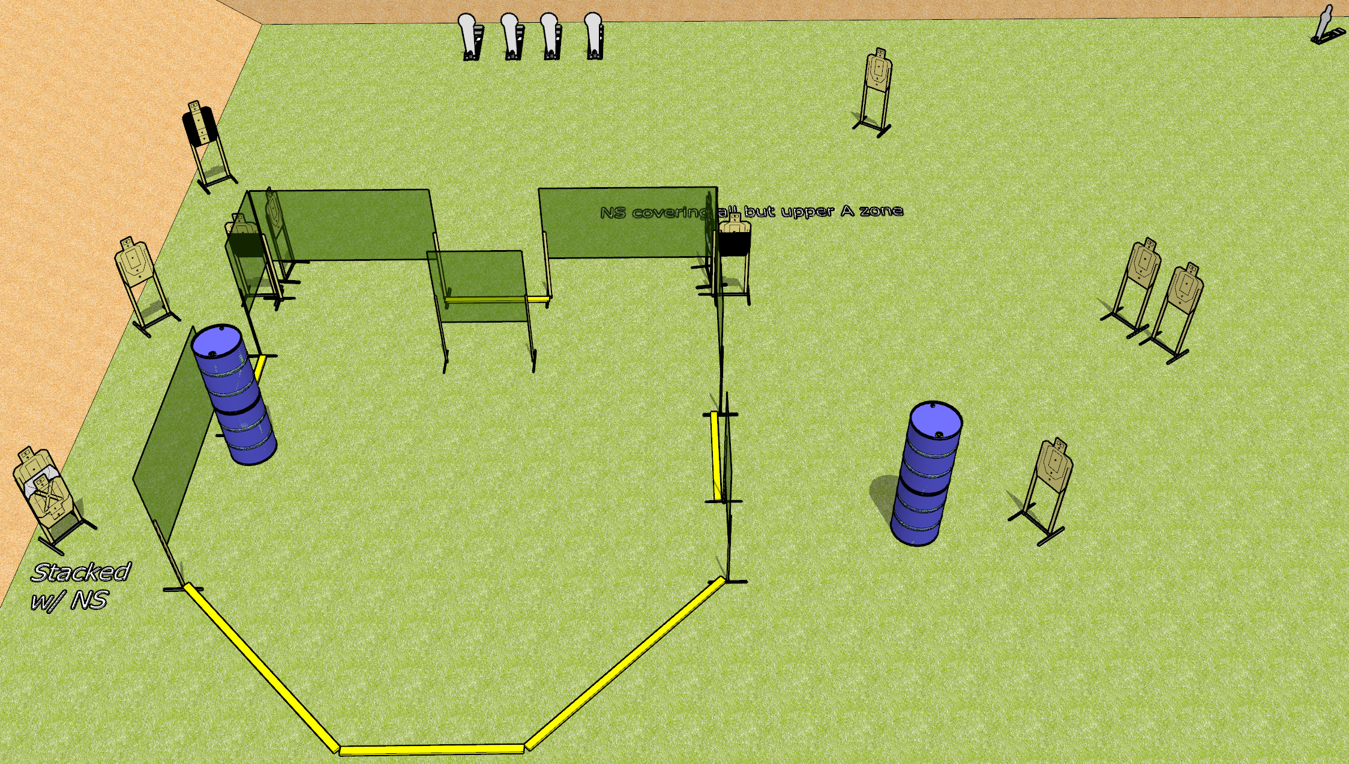
 | Dothan Gun Club – USPSA Match Lean Out Course Designer : Drew Coleman
Round Count 29 rounds 12 USPSA 4 colt poppers, 1 mini popper
Equipment List 12 wall feet 3-4 medium fault lines 1 tuxedo, 2 50%

Slide 2
Lean Out
Written Stage Briefing
Lean Out is a 29 round, 145 point, Comstock course of fire. There are 12 USPSA targets, 4 colt poppers, and 1 mini poppers. The best 2 hits on paper will score, and steel must fall to score. The start signal is audible.
Handgun start position is anywhere outside the shooting area, wrists below belt. Handgun is loaded and holstered.
PCC start position is anywhere outside the shooting area, stock on belt. Loaded carbine is held with both hands, safety on.
On start signal, engage targets as they become available from within the shooting area.

